Slide 1
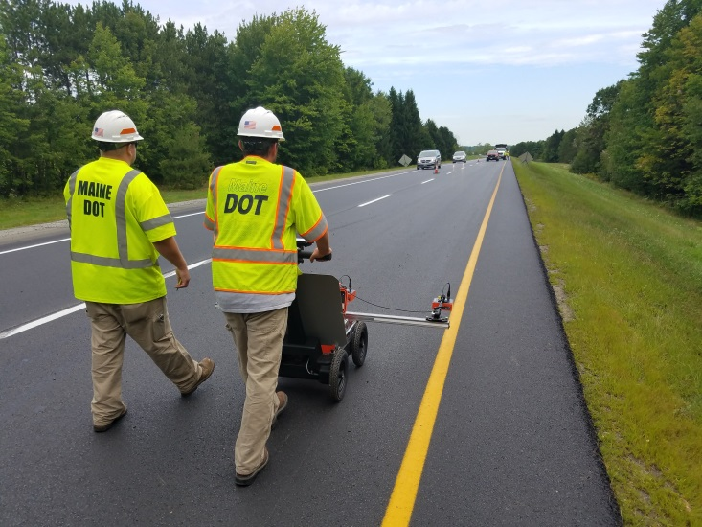
DPS GPR – 2021 data
Ulrich Amoussou-Guenou

Slide 2
SUMMARY
Summary of data collected
Distribution Curves
  Rubber Mix project: 12.5mm NMAS - WMA 1-3/4” Mill & Fill (Night Work):
  0.53 miles collected on Interstate 295 Southband in Portland
  9.5 mm Mix – HMA 1-1/4” Overlay (Day Work): 0.85 miles collected on Route 201
  Northbound lane in Moscow
Contour Map
  Rubber Mix
Calibration Curves
Findings
What next

Slide 3
Data | Mean | Std Deviation
Dielectric - 1ft RT | 4.812 | 0.160
Dielectric - 3ft RT | 5.032 | 0.153
Dielectric - 5ft RT | 5.211 | 0.215
Dielectric - 7ft RT | 5.084 | 0.189
Dielectric - 9ft RT | 5.091 | 0.149
Dielectric - 11ft RT | 5.029 | 0.150
Minimum | 4.812 | 0.149
Maximum | 5.211 | 0.215

Slide 4
Data | Mean | Std Deviation
Dielectric - 1ft RT | 5.312 | 0.134
Dielectric - 3ft RT | 5.354 | 0.133
Dielectric - 5ft RT | 5.381 | 0.115
Dielectric - 7ft RT | 5.425 | 0.136
Dielectric - 9ft RT | 5.394 | 0.117
Dielectric - 11ft RT | 5.245 | 0.133
Minimum | 5.245 | 0.115
Maximum | 5.425 | 0.136

Slide 10
Comparison between core density and density using pucks calibration equation
Acceptance Core | Test Location | Offset | Core Density | Measured Dielectric | Air Voids (%) using calibration equation | Density (%) using calibration equation | Δ Density (%)
Core 1 | 95+92 | 3.2 RT | 93.6 | 5.33 | 4.1 | 95.9 | 2.3
Core 2 | 164+87 | 4 RT | 93.3 | 5.13 | 6.9 | 93.1 | -0.2

Slide 11
Findings
Lower dielectric and slightly wider range for the 12.5 mm rubber mix project (Mean 5.04, Std dev: 0.21) vs. (Mean: 5.35, Std dev: 0.14) for the 9.5 mm standard mix. Which suggest a more uniform compaction pattern for the second project. (2 knock down rollers used for the first project vs 1 knock down roller for the second project).
Lowest values close to the joints even though confined (centerline joint: 1-ft and shoulder: 11-ft) and highest values in the middle of the lane. Typically, with 2 knock down rollers the highest values are in the wheel path (3-ft and 9-ft offset).
Too much variability in the rubber mix data calibration (Almost 0.2 in the 62.4 mm thick pucks and nearly 0.1 in the 115 mm pucks) for the same airvoid. It is suspected that a nearby radio room is affecting the readings.
The 115 mm samples calibration seem to be more accurate compared to the 62.4 mm for both projects. This was expected.
The pucks calibration doesn’t seem to align with the field dielectrics.
The paver stops locations on the contour map indicate low dielectric values.

Slide 12
What next
Confirm the interference of radio signal on the rubber mix pucks calibration due to the proximity of a radio room to the room where the calibration was done for the rubber mix specimen.
Confirm that the 115 mm thickness in the way to go (compared to the 62.4 mm).
Establish the correlation between the cores calibration and the pucks calibration .
Find the minimum pavement thickness that allow or guaranty valid dielectric data collection in the field.
Use the RDM survey in conjunction with others new technologies such as pave IR for complementarity and correlation.

Slide 13
Thank you for your attention

